Slide 1
﷽
CONVOLUTIONAL NEURAL NETWORKS IN PRACTICE
Decoding Facial Expressions
Depressive vs. Neutral — A CNN Case Study
From convolutional neural networks in general, to the exact architecture trained on this dataset in PyTorch — with real results from a completed training run.
PRESENTED BY
PRESENTED TO
Muhammad Asad Riaz
Sir Kamran Younis

Slide 2
FOUNDATIONS
What is a convolutional neural network?
A CNN learns to recognize visual patterns by passing an image through repeated layers that extract, compress, and finally classify features.
Input
Image
Convolution
Activation
(ReLU)
Pooling
(repeat)
Flatten
Fully
Connected
Output
Classes
Convolution
Activation (ReLU)
Pooling
Fully Connected
Slides small filters across the image, each learning to detect one visual pattern (an edge, a curve, a texture).
Introduces non-linearity — max(0, x) — so the network can approximate complex, non-linear decision boundaries.
Downsamples feature maps (e.g. take the max in each 2×2 window), keeping the strongest signal and reducing computation.
Flattens the final feature maps into a vector and combines them into class scores (logits).

Slide 3
CONTEXT
Other well-known CNN architectures
Before looking at the architecture used for this project, here's where it sits among widely-used CNN designs.
1998
2014
2015
2019
LeNet-5
VGG-16
ResNet-50
EfficientNet
First practical CNN — digit recognition
Deep stacks of small 3×3 convolutions
Residual/skip connections enable very deep nets
Compound scaling of depth/width/resolution
2012
2014
2017
AlexNet
GoogLeNet
MobileNet
ReLU + dropout + GPU training; ImageNet breakthrough
Inception modules; multi-scale filters per layer
Depthwise-separable convs for mobile efficiency

Slide 4
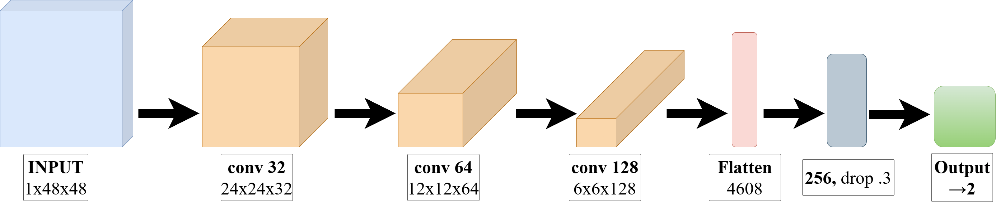
PROJECT'S MODEL
EmotionCNN — the architecture trained on this dataset
3 convolutional blocks (Conv → BatchNorm → ReLU → MaxPool) doubling channels while halving spatial size, then a dropout-regularized classifier head.

Slide 5
SCOPE & FRAMING
What this model is — and is not
This dataset is a relabeled facial-expression set (derived from the classic FER-style emotion images) — it is not clinically-diagnosed depression data.
A CNN trained on it learns to recognize an expression pattern the dataset creator labeled “depressive,” not to diagnose depression. Facial expression alone is not a validated clinical marker of depression.
1
2
3
Emotion-image classification demo
Not a diagnostic tool
Every result in this deck is real
Learns visual expression patterns from a labeled image set.
No clinical validation; outputs should never be read as a mental-health assessment.
Real training run, real numbers — reported with this caveat attached.

Slide 6
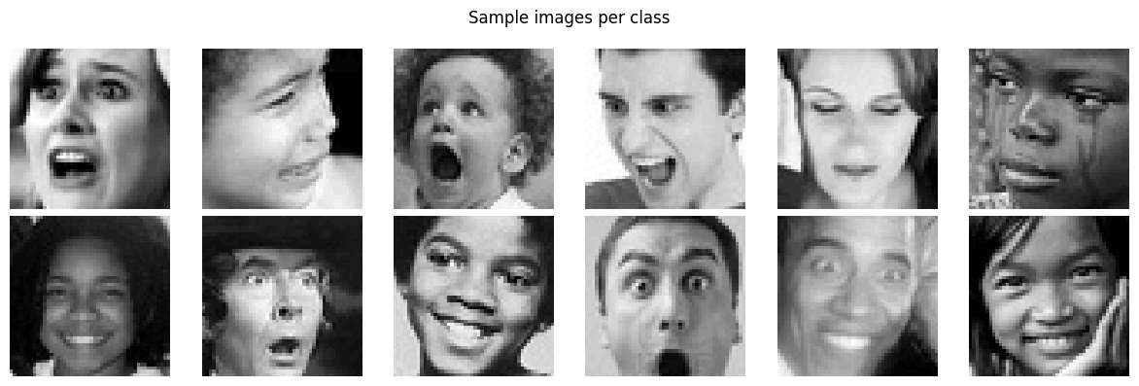
DATASET
Two-class facial-expression dataset
Dataset properties
Sample images per class
Source
Kaggle — gudiyasingh/emotion-dataset-for-mental-health
Classes
Depressive, Neutral
Image size
48 × 48
Color mode
Grayscale (1 channel)
Format
PNG / JPG
Split
Train / Validation / Test (author-provided)
License
CC0: Public Domain
Top row: depressive-labeled · Bottom row: neutral-labeled · raw dataset thumbnails, unaugmented
3,229 depressive • 3,838 neutral
images per split (train, validation, and test each carry this class distribution)

Slide 7
SAMPLE DATA PREPARATION
From raw image to model input
1
Grayscale
Force 1 channel for safety (images are already grayscale).
2
Resize
48 × 48 — native size, no upsampling needed.
3
Augment (train only)
Random horizontal flip (p=0.5) + random rotation (±10°) to curb overfitting.
4
ToTensor
Scales pixel values from [0, 255] to [0.0, 1.0].
5
Normalize
Zero-center with dataset mean=0.5057, std=0.2128 — stabilizes gradient-based training.

Slide 8
TRAINING PROCESS
Training configuration
OPTIMIZER
LR SCHEDULE
LOSS FUNCTION
Adam
ReduceLROnPlateau
CrossEntropyLoss
lr = 1e-3
factor 0.5, patience 3, on val loss
softmax applied internally
BATCH SIZE
EPOCHS
REGULARIZATION
64
30
BatchNorm + Dropout
early-stopped on best val loss
0.4 / 0.3 + light augmentation
One manual optimizer step, traced end to end: loss 0.7423 → backward() → gradients confirmed flowing from fc2 (norm 1.20) all the way back to block1 conv (norm 0.32) → optimizer.step() → loss 2.6395.

Slide 9
TRAINING PROCESS
Training run — loss & accuracy

Slide 10
RESULTS
Test-set performance
Confusion matrix — test set
TEST ACCURACY
Predicted
82.7%
Depressive
Neutral
Depressive
2713
516
7,067 held-out test images
Class Precision Recall F1
True
Depressive
0.79
0.84
0.82
Neutral
705
3133
Neutral
0.86
0.82
0.84
Macro avg
0.83
0.83
0.83
Best checkpoint: epoch 29 · val loss 0.3688 · val acc 82.7%

Slide 11
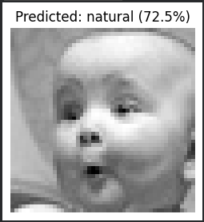
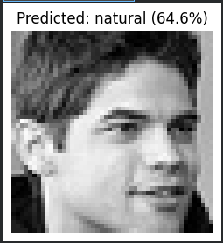
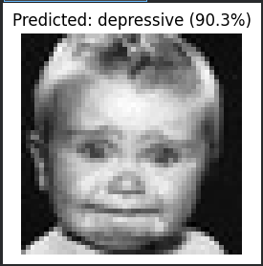
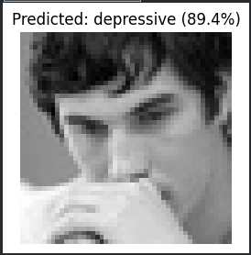
RESULTS
Live inference on new photos
The trained checkpoint's predict_image() pipeline run on four photos uploaded directly through the notebook's file-upload widget.
Natural
Natural
Depressive
Depressive
(72.5% confidence)
(64.6% confidence)
(90.3% confidence)
(89.4% confidence)
dep.
27.5%
dep.
35.4%
dep.
90.3%
dep.
89.4%
nat.
72.5%
nat.
64.6%
nat.
9.7%
nat.
10.6%

Slide 12
Jazak ALLAH
Any Question.

